Slide 1

CS344AI: IOT and Embedded Computing
Unit-1:Introduction to Embedded Systems

Slide 2

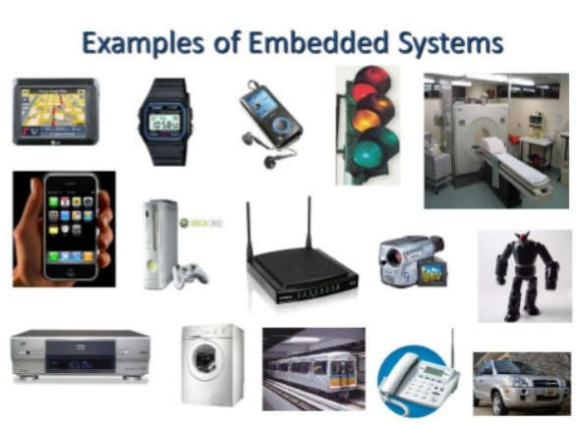

Slide 3



Slide 4
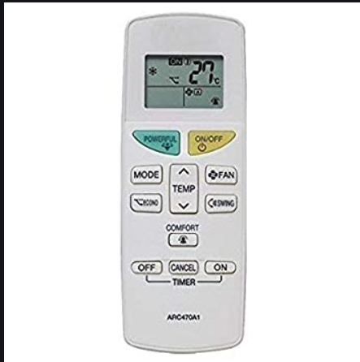


Slide 5
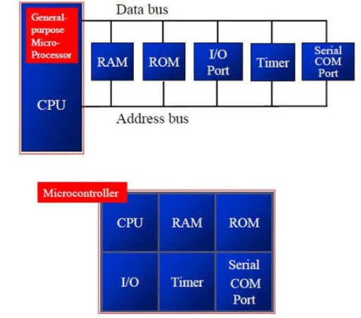
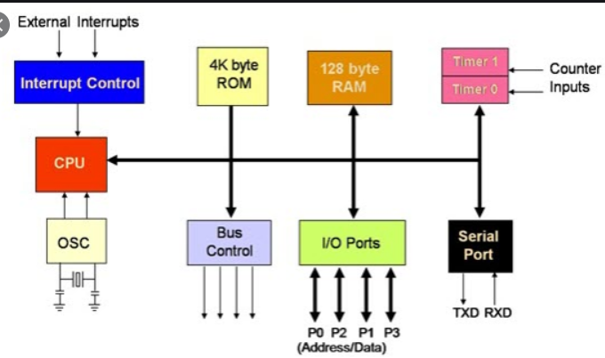

Slide 6
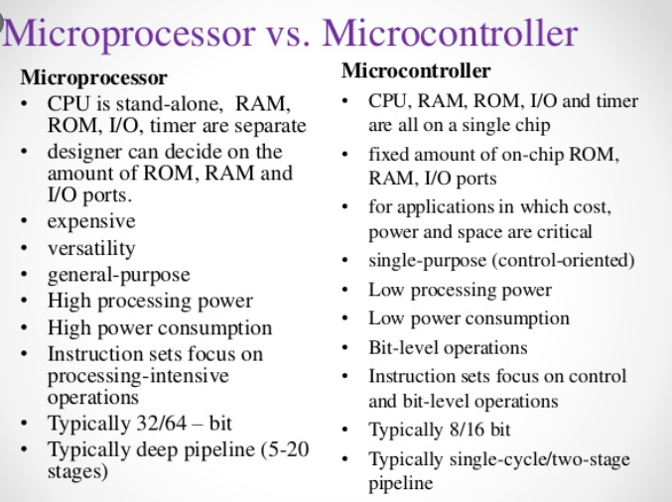

Slide 7
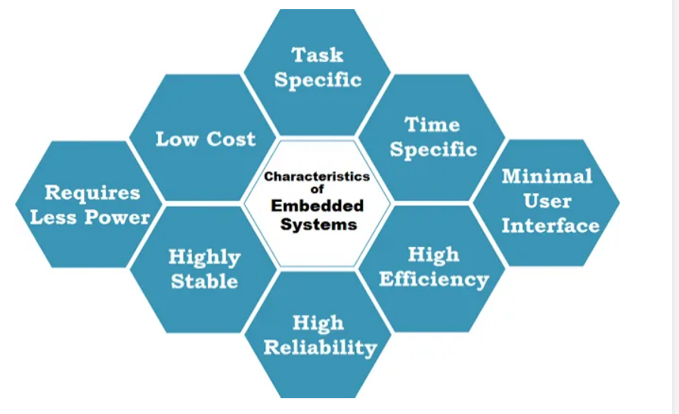
Characteristics of embedded systems

Slide 8
Some of the key characteristics of Embedded Systems are as mentioned below.
All Embedded Systems are task specific. They do the same task repeatedly /continuously over their lifetime. An mp3 player will function only as an mp3 player.
Embedded systems are created to perform the task within a certain time frame. It must therefore perform fast enough. A car’s brake system, if exceeds the time limit, may cause accidents.
They have minimal or no user interface (UI). A fully automatic washing machine works on its own after the program is set and stops once the task is over.
Some embedded systems are designed to react to external stimuli and react accordingly. A thermometer, a GPS tracking device.
Embedded systems are built to achieve certain efficiency levels. They are small sized, can work with less power and are not too expensive.
Embedded systems cannot be changed or upgraded by the users. Hence, they must rank high on reliability and stability. They are expected to function for long durations without the user experiencing any difficulties.
Microcontroller or microprocessors are used to design embedded systems.
Embedded systems need connected peripherals to attach input & output devices.
The hardware of an embedded-system is used for security and performance. The Software is used for features.

Slide 9
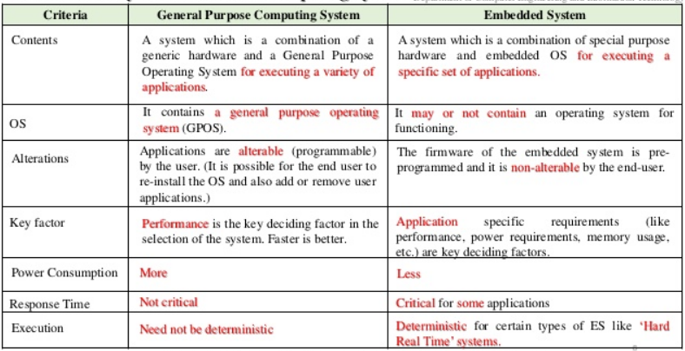

Slide 10
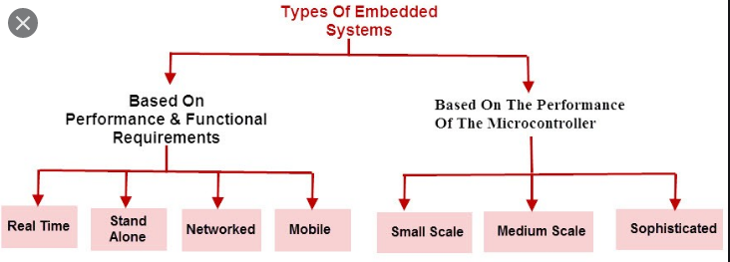
Real-Time Embedded Systems:
Traffic control system
Military usage in defense sector
Medical usage in health sector
Stand Alone Embedded Systems :
MP3 players
Microwave ovens
calculator
Networked Embedded Systems :
Home security systems
ATM machine
Card swipe machine
Mobile Embedded Systems :
MP3 player
Mobile phones
Digital Camera

Slide 11
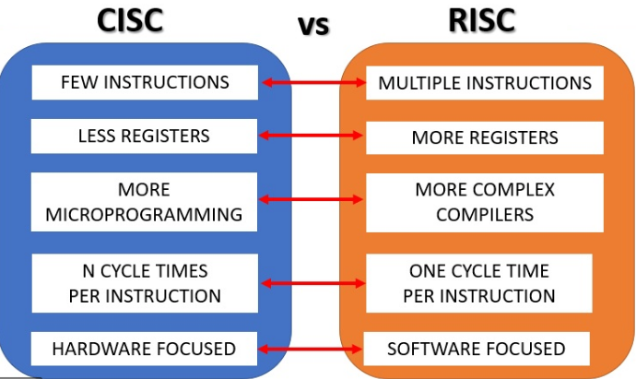

Slide 12
Introduction to ARM
Introduction
Architecture
Programmers Model
Instruction Set
Notes:
Programmers Model
The structure of the ARM architecture
How it has developed
Register set, modes and exceptions
The endian issue

Slide 13



ARM Processor Families
1

Slide 14
ARM Cortex Processor Families
A Profile : Application processors which are designed to handle complex applications such as high-end embedded operating systems (OSs)
-These processors requiring the highest processing power, virtual memory system support with memory management units (MMUs).
E.g: High-end mobile phones(Samsung S6: Samsung Eqynos).
R Profile: Real-time, high-performance processors targeted primarily at the higher end of the real-time market.
-Those applications, such as high-end breaking systems and hard drive controllers, in which high processing power and high reliability are essential and for which low latency is important.
M Profile : Processors targeting low-cost applications in which processing efficiency is important and cost, power consumption, low interrupt latency, and ease of use are critical.
2
MGR,ECE,RVCE

Slide 15

ARM Processor Families contd..
Neoverse N1: Delivering market-leading server performance at the half the power, the N1 CPU ushers in a revolutionary era of compute efficiency or performance/watt. Targeted for server work loads and data centres.
Ethos : Highly scalable and efficient NPU, the Ethos enables new immersive applications with a 2.5x increase in single-core performance now scalable from 1 to 10 TOP/s and beyond through many-core technologies. It provides flexibility to optimize the ML capability and IoT applications.
Source: www.arm.com
3
MGRJ,ECE

Slide 16
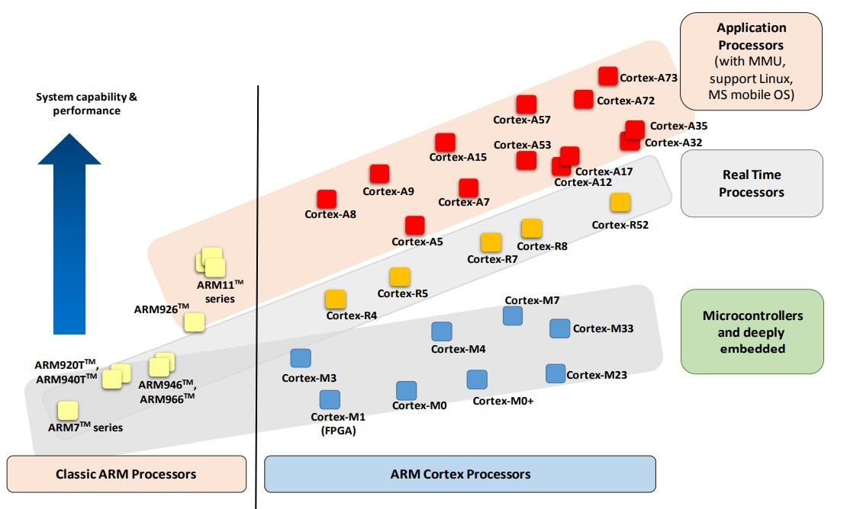
ARM Processor Families
4
MGR,ECE,RVCE

Slide 17

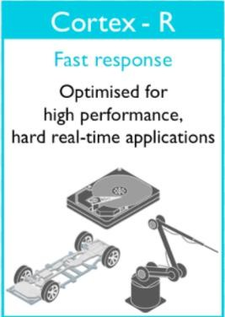
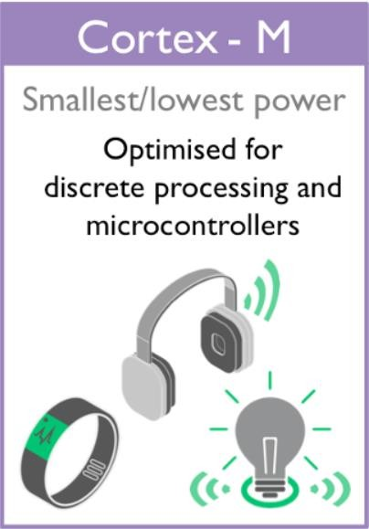



Typical Application Domains
5
MGR,ECE,RVCE
Source: google

Slide 18
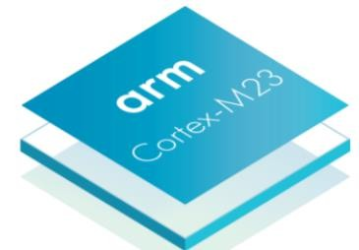
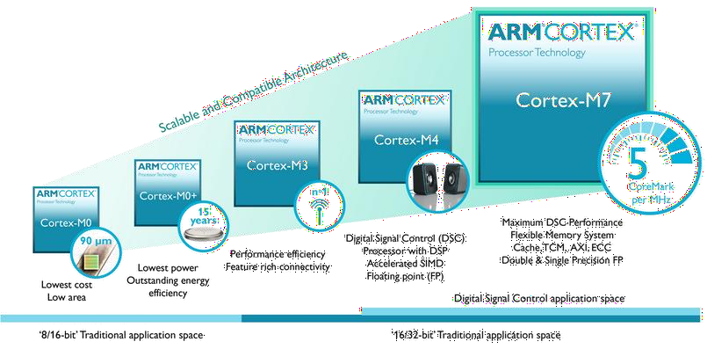
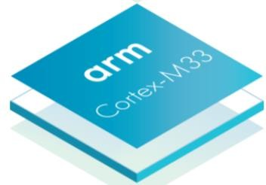
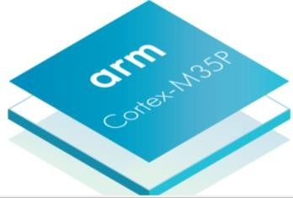
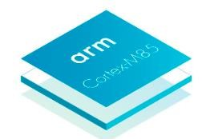
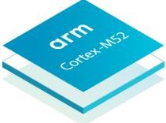
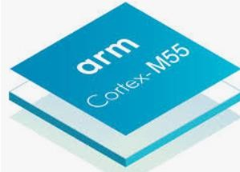
ARM Cortex-M Series
6
For more info on CoreMark: www.eembc.org
MGR,ECE,RVCE

Slide 19
CoreMark
CoreMark is small, portable, easy to understand, free, and displays a single number benchmark score to represent the speed of processors.
A processor with higher CoreMark number is faster. This rating is given by CoreMark consortium.
Earlier DMIPS(Dhrystone Million Instructions Per second) is the metrics used specify the speed of processors.
To avoid the problems associated with the DMIPS(Dhrystone MIPS), CoreMark rating is introduced.
More info on CoreMark: https://www.eembc.org/coremark/
7
MGR,ECE,RVCE

Slide 20
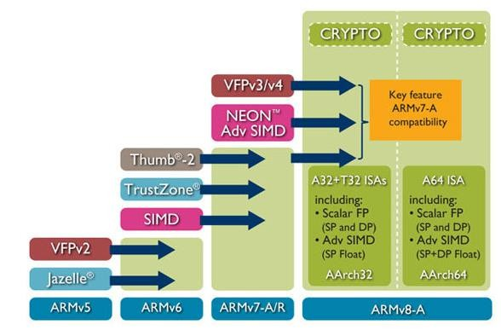
ARM Instruction Versions
Security
ML
DSP
ARMv9-A
ARMv7-M
ARMv8-R/M
www.arm.com
8
MGR,ECE,RVCE

Slide 21
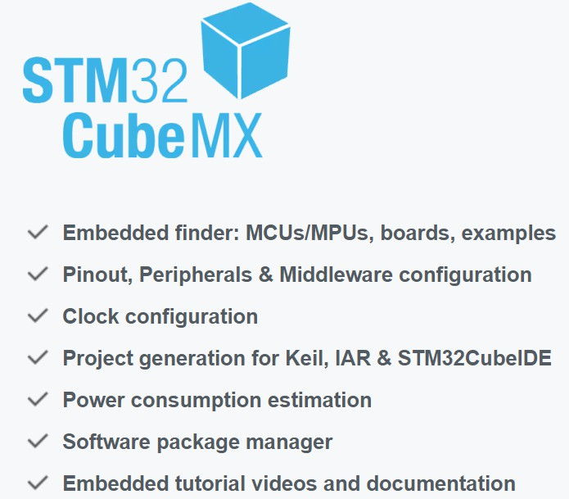
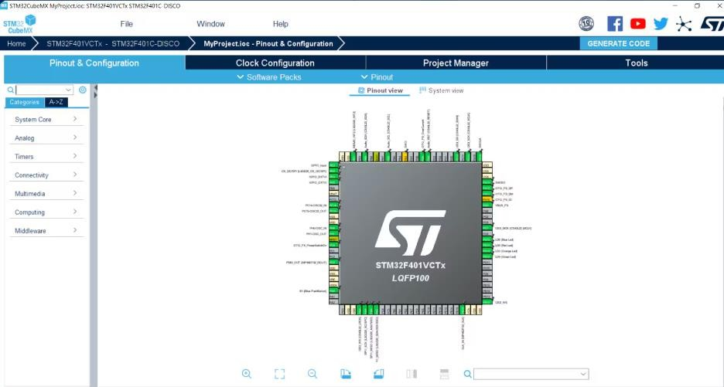
9
MGR,ECE,RVCE

Slide 22
History of ARM
ARM (Acorn RISC Machine) started as a new, powerful, CPU design for the replacement of the 8-bit 6502 in Acorn Computers (Cambridge, UK, 1985)
First models had only a 26-bit program counter, limiting the memory space to 64 MB (not too much by today standards, but a lot at that time).
1990 spin-off: ARM renamed Advanced RISC Machines
ARM now focuses on Embedded CPU cores
IP licensing: Almost every silicon manufacturer sells some microcontroller with an ARM core. Some even compete with their own designs.
Processing power with low current consumption
Good MIPS/Watt figure
Ideal for portable devices
Compact memories: 16-bit opcodes (Thumb)
New cores with added features
Harvard architecture (ARM9, ARM11, Cortex)
Floating point arithmetic
Vector computing (VFP, NEON)
Java language (Jazelle)

Slide 23
Facts
32-bit CPU
3-operand instructions (typical): ADD Rd,Rn,Operand2
RISC design…
Few, simple, instructions
Load/store architecture (instructions operate on registers, not memory)
Large register set
Pipelined execution
… And some very specific details
No stack. Link register instead
PC as a regular register
Conditional execution of all instructions
Flags altered or not by data processing instructions (selectable)
Concurrent shifts/rotations (at the same time of other processing)
…

Slide 24
ARM7TDMI
Block Diagram

Slide 25
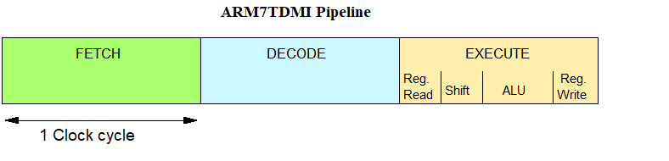
ARM Pipelining examples
Fetch: Read Op-code from memory to internal Instruction Register
Decode: Activate the appropriate control lines depending on Opcode
Execute: Do the actual processing

Slide 26
ARM7TDMI Pipelining (I)
Simple instructions (like ADD) Complete at a rate of one per cycle

Slide 27
Data Sizes and Instruction Sets
The ARM is a 32-bit architecture.
When used in relation to the ARM:
Byte means 8 bits
Halfword means 16 bits (two bytes)
Word means 32 bits (four bytes)
Most ARM’s implement two instruction sets
32-bit ARM Instruction Set
16-bit Thumb Instruction Set
Notes:
The cause of confusion here is the term “word” which will mean 16-bits to people with a 16-bit background.
In the ARM world 16-bits is a “halfword” as the architecture is a 32-bit one, whereas “word” means 32-bits.
Java bytecodes are 8-bit instructions designed to be architecture independent. Jazelle transparently executes most bytecodes in hardware and some in highly optimized ARM code. This is due to a tradeoff between hardware complexity (power consumption & silicon area) and speed.

Slide 28
Processor Modes
The ARM has seven operating modes:
User : unprivileged mode under which most tasks run
FIQ : entered when a high priority (fast) interrupt is raised
IRQ : entered when a low priority (normal) interrupt is raised
SVC : (Supervisor) entered on reset and when a Software Interrupt
instruction is executed
Abort : used to handle memory access violations
Undef : used to handle undefined instructions
System : privileged mode using the same registers as user mode
Notes:
The Programmers Model can be split into two elements - first of all, the processor modes and secondly, the processor registers. So let’s start by looking at the modes.
Now the typical application will run in an unprivileged mode know as “User” mode, whereas the various exception types will be dealt with in one of the privileged modes : Fast Interrupt, Supervisor, Abort, Normal Interrupt and Undefined (and we will look at what causes each of the exceptions later on).
NB - spell out the word FIQ, otherwise you are saying something rude in German!
One question here is what is the difference between the privileged and unprivileged modes? Well in reality very little really - the ARM core has an output signal (nTRANS on ARM7TDMI, InTRANS, DnTRANS on 9, or encoded as part of HPROT or BPROT in AMBA) which indicates whether the current mode is privileged or unprivileged, and this can be used, for instance, by a memory controller to only allow IO access in a privileged mode. In addition some operations are only permitted in a privileged mode, such as directly changing the mode and enabling of interrupts.
All current ARM cores implement system mode (added in architecture v4). This is simply a privileged version of user mode. Important for re-entrant exceptions because no exceptions can cause system mode to be entered.

Slide 29
The Registers
ARM has 37 registers all of which are 32-bits long.
1 dedicated program counter
1 dedicated current program status register
5 dedicated saved program status registers
30 general purpose registers
The current processor mode governs which of several banks is accessible. Each mode can access
a particular set of r0-r12 registers
a particular r13 (the stack pointer, sp) and r14 (the link register, lr)
the program counter, r15 (pc)
the current program status register, cpsr
Privileged modes (except System) can also access
a particular spsr (saved program status register)
Notes:
The ARM architecture provides a total of 37 registers, all of which are 32-bits long. However these are arranged into several banks, with the accessible bank being governed by the current processor mode. We will see this in more detail in a couple of slides. In summary though, in each mode, the core can access:
a particular set of 13 general purpose registers (r0 - r12).
a particular r13 - which is typically used as a stack pointer. This will be a different r13 for each mode, so allowing each exception type to have its own stack.
a particular r14 - which is used as a link (or return address) register. Again this will be a different r14 for each mode.
r15 - whose only use is as the Program counter.
The CPSR (Current Program Status Register) - this stores additional information about the state of the processor:
And finally in privileged modes, a particular SPSR (Saved Program Status Register). This stores a copy of the previous CPSR value when an exception occurs. This combined with the link register allows exceptions to return without corrupting processor state.

Slide 30
The ARM Register Set
Current Visible Registers
Current Visible Registers
Current Visible Registers
Current Visible Registers
Current Visible Registers
Current Visible Registers
r0
r0
r0
r0
r0
r0
Abort Mode
r0
SVC Mode
Undef Mode
FIQ Mode
User Mode
IRQ Mode
r1
r1
r1
r1
r1
r1
r1
r2
r2
r2
r2
r2
r2
r2
Banked out Registers
Banked out Registers
Banked out Registers
Banked out Registers
Banked out Registers
r3
Banked out Registers
r3
r3
r3
r3
r3
r3
r4
r4
r4
r4
r4
r4
r4
r5
r5
r5
r5
r5
r5
r5
User,
SYS
User
User
User
User
FIQ
FIQ
FIQ
FIQ
FIQ
FIQ
IRQ
IRQ
IRQ
IRQ
IRQ
IRQ
SVC
SVC
SVC
SVC
SVC
SVC
Undef
Undef
Undef
Undef
Undef
Undef
Abort
Abort
Abort
Abort
Abort
r6
Abort
r6
r6
r6
r6
r6
r6
r7
r7
r7
r7
r7
r7
r7
r8
r8
r8
r8
r8
r8
r8
r8
r8
r8
r8
r8
r8
r8
r9
r9
r9
r9
r9
r9
r9
r9
r9
r9
r9
r9
r9
r9
r10
r10
r10
r10
r10
r10
r10
r10
r10
r10
r10
r10
r10
r10
r11
r11
r11
r11
r11
r11
r11
r11
r11
r11
r11
r11
r11
r11
r12
r12
r12
r12
r12
r12
r12
r12
r12
r12
r12
r12
r12
r12
r13 (sp)
r13 (sp)
r13 (sp)
r13 (sp)
r13 (sp)
r13 (sp)
r13 (sp)
r13 (sp)
r13 (sp)
r13 (sp)
r13 (sp)
r13 (sp)
r13 (sp)
r13 (sp)
r13 (sp)
r13 (sp)
r13 (sp)
r13 (sp)
r13 (sp)
r13 (sp)
r13 (sp)
r13 (sp)
r13 (sp)
r13 (sp)
r13 (sp)
r13 (sp)
r13 (sp)
r13 (sp)
r13 (sp)
r13 (sp)
r13 (sp)
r13 (sp)
r13 (sp)
r13 (sp)
r13 (sp)
r13 (sp)
r13 (sp)
r13 (sp)
r13 (sp)
r13 (sp)
r13 (sp)
r13 (sp)
r14 (lr)
r14 (lr)
r14 (lr)
r14 (lr)
r14 (lr)
r14 (lr)
r14 (lr)
r14 (lr)
r14 (lr)
r14 (lr)
r14 (lr)
r14 (lr)
r14 (lr)
r14 (lr)
r14 (lr)
r14 (lr)
r14 (lr)
r14 (lr)
r14 (lr)
r14 (lr)
r14 (lr)
r14 (lr)
r14 (lr)
r14 (lr)
r14 (lr)
r14 (lr)
r14 (lr)
r14 (lr)
r14 (lr)
r14 (lr)
r14 (lr)
r14 (lr)
r14 (lr)
r14 (lr)
r14 (lr)
r14 (lr)
r14 (lr)
r14 (lr)
r14 (lr)
r14 (lr)
r14 (lr)
r14 (lr)
r15 (pc)
r15 (pc)
r15 (pc)
r15 (pc)
r15 (pc)
r15 (pc)
r15 (pc)
cpsr
cpsr
cpsr
cpsr
cpsr
cpsr
cpsr
spsr
spsr
spsr
spsr
spsr
spsr
spsr
spsr
spsr
spsr
spsr
spsr
spsr
spsr
spsr
spsr
spsr
spsr
spsr
spsr
spsr
spsr
spsr
spsr
spsr
spsr
spsr
spsr
spsr
spsr
spsr
spsr
spsr
spsr
spsr
Notes:
This animated slide shows the way that the banking of registers works. On the left the currently visible set of registers are shown for a particular mode.
On the right are the registers that are banked out whilst in that mode.
Each key press will switch mode:
user -> FIQ ->user -> IRQ -> user ->SVC -> User -> Undef -> User -> Abort and then back to user.
The following slide then shows this in a more static way that is more useful for reference

Slide 31
Special Registers
Special function registers:
PC (R15): Program Counter. Any instruction with PC as its destination register is a program branch
LR (R14): Link Register. Saves a copy of PC when executing the BL instruction (subroutine call) or when jumping to an exception or interrupt routine
- It is copied back to PC on the return from those routines
SP (R13): Stack Pointer. There is no stack in the ARM architecture. Even so, R13 is usually reserved as a pointer for the program-managed stack
CPSR : Current Program Status Register. Holds the visible status register
SPSR : Saved Program Status Register. Holds a copy of the previous status register while executing exception or interrupt routines
- It is copied back to CPSR on the return from the exception or interrupt
- No SPSR available in User or System modes
Notes:
The Programmers Model can be split into two elements - first of all, the processor modes and secondly, the processor registers. So let’s start by looking at the modes.
Now the typical application will run in an unprivileged mode know as “User” mode, whereas the various exception types will be dealt with in one of the privileged modes : Fast Interrupt, Supervisor, Abort, Normal Interrupt and Undefined (and we will look at what causes each of the exceptions later on).
NB - spell out the word FIQ, otherwise you are saying something rude in German!
One question here is what is the difference between the privileged and unprivileged modes? Well in reality very little really - the ARM core has an output signal (nTRANS on ARM7TDMI, InTRANS, DnTRANS on 9, or encoded as part of HPROT or BPROT in AMBA) which indicates whether the current mode is privileged or unprivileged, and this can be used, for instance, by a memory controller to only allow IO access in a privileged mode. In addition some operations are only permitted in a privileged mode, such as directly changing the mode and enabling of interrupts.
All current ARM cores implement system mode (added in architecture v4). This is simply a privileged version of user mode. Important for re-entrant exceptions because no exceptions can cause system mode to be entered.

Slide 32
Register Organization Summary
User,
SYS
FIQ
IRQ
SVC
Undef
Abort
r0
User mode r0-r7, r15, and cpsr
User mode r0-r12, r15, and cpsr
User mode r0-r12, r15, and cpsr
User mode r0-r12, r15, and cpsr
User mode r0-r12, r15, and cpsr
r1
r2
r3
r4
r5
r6
r7
r8
r8
r9
r9
r10
r10
r11
r11
r12
r12
r13 (sp)
r13 (sp)
r13 (sp)
r13 (sp)
r13 (sp)
r13 (sp)
r14 (lr)
r14 (lr)
r14 (lr)
r14 (lr)
r14 (lr)
r14 (lr)
r15 (pc)
cpsr
spsr
spsr
spsr
spsr
spsr
Note: System mode uses the User mode register set
Notes:
This slide shows the registers visible in each mode - basically in a more static fashion than the previous animated slide that is more useful for reference.
The main point to state here is the splitting of the registers in Thumb state into Low and High registers.
ARM register banking is the minimum necessary for fast handling of overlapping exceptions of different types (e.g. ABORT during SWI during IRQ). For nested exceptions of the same type (e.g. re-entrant interrupts) some additional pushing of registers to the stack is required.

Slide 33
Program Status Registers
Condition code flags
N = Negative result from ALU
Z = Zero result from ALU
C = ALU operation Carried out
V = ALU operation oVerflowed
Interrupt Disable bits.
I = 1: Disables the IRQ.
F = 1: Disables the FIQ.
T Bit (Arch. with Thumb mode only)
T = 0: Processor in ARM state
T = 1: Processor in Thumb state
Never change T directly (use BX instead)
Changing T in CPSR will lead to unexpected behavior due to pipelining
Tip: Don’t change undefined bits.
This allows for code compatibility with newer ARM processors
Mode bits
10000 User
10001 FIQ
10010 IRQ
10011 Supervisor
10111 Abort
11011 Undefined
11111 System
Notes:
Green psr bits are only in certain versions of the ARM architecture
ALU status flags (set if "S" bit set, implied in Thumb state).
Sticky overflow flag (Q flag) is set either when
saturation occurs during QADD, QDADD, QSUB or QDSUB, or
the result of SMLAxy or SMLAWx overflows 32-bits
Once flag has been set can not be modified by one of the above instructions and must write to CPSR using MSR instruction to cleared
PSRs split into four 8-bit fields that can be individually written:
Control (c) bits 0-7
Extension (x) bits 8-15 Reserved for future use
Status (s) bits 16-23 Reserved for future use
Flags (f) bits 24-31
Bits that are reserved for future use should not be modified by current software. Typically, a read-modify-write strategy should be used to update the value of a status register to ensure future compatibility. Note that the T/J bits in the CPSR should never be changed directly by writing to the PSR (use the BX/BXJ instruction to change state instead).
However, in cases where the processor state is known in advance (e.g. on reset, following an interrupt, or some other exception), an immediate value may be written directly into the status registers, to change only specific bits (e.g. to change mode).
New ARM V6 bits now shown.

